Slide 1

AI GREYSCALE
IMAGE COLORIZATION
Monalika Goel
Khwaish Gahoi
Paras Chawla
22CSU246
22CSU363
22CSU337

Slide 2

TABLE OF CONTENT
01
06
Inroduction
Model Architecture
02
07
Objective
Evaluation Metrics
03
08
Tech Stack
Results
04
09
Features
Challenges
05
10
Dataset Description
Conclusion

Slide 3
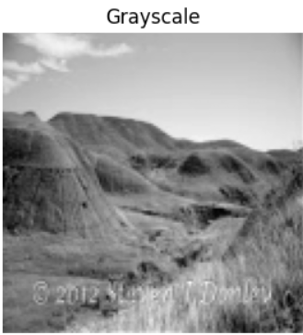
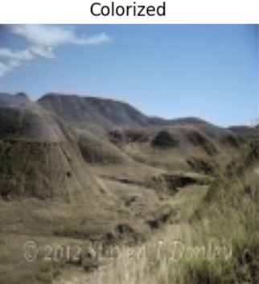
INTRODUCTION
Image colorization adds color to greyscale images, with applications in restoration, digital media.
Traditional methods required manual input, but deep learning enables fully automated, scalable solutions.
This study focuses on mountainous and forested landscapes, which are challenging due to subtle color variations, especially in blue and green tones.
A lightweight U-Net architecture was used for efficiency, enhanced with dropout and data augmentation for improved performance.

Slide 4

OBJECTIVE
Develop an efficient convolutional neural network (CNN) capable of automatically adding realistic color to greyscale landscape images, focusing on mountainous and forested environments.
Evaluate the model’s performance using perceptual quality metrics such as SSIM (Structural Similarity Index), MSE (Mean Squared Error) and PSNR (Peak Signal-to-Noise Ratio), which reflect visual similarity and image fidelity.

Slide 5

DATASET DESCRIPTION
•Places 365 dataset was reduced to a subset which contains 5000 pictures of mountains and forest each.
•Images are stored in .tar.gz archives and extracted programmatically.
•Each category is loaded, resized, normalized, and used for training the CNN model.

Slide 6
MODEL ARCHITECTURE
•The model is a custom Convolutional Neural Network (U-Net).
•Includes multiple Conv2D, UpSampling2D, and Batch Normalization layers.
•Uses Mean Squared Error loss and Adam optimizer.

Slide 7



TECH STACK
TECHNOLOGIES USED
Python, NumPy, OpenCV
Tensorflow(Keras)
Streamlit
Enable manipulation, array operations, and integration with deep learning models for colorization tasks.
Used for building, training, and evaluating the deep learning model efficiently.
For building an interactive web app to visualize and deploy the model.

Slide 8

FEATURES
•Automatic dataset extraction from compressed tar.gz files.
•Custom CNN, lightweight U-Net architecture for image colorization.
•Use of SSIM and PSNR as evaluation metrics.
•Visualization of model output vs original color image.

Slide 9
EVALUATION METRICS
•Structural Similarity Index (SSIM): The model procured a SSIM of 0.8930, indicates a good degree of similarity between two images, but not a perfect match.
•Peak Signal-to-Noise Ratio (PSNR): The model attained an average PSNR of 29.00 dB, which reflects high visual fidelity and low reconstruction noise.
•Mean Squared Error (MSE): The model achieved an MSE of 0.0075, indicating minimal deviation in chromatic reconstruction.

Slide 10
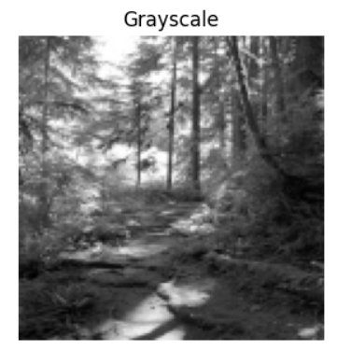
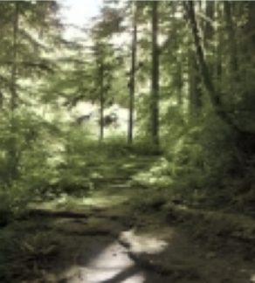
RESULTS
01
Successful Image Colorization
Our deep learning model effectively colorizes grayscale landscape images with high visual accuracy.
02
Quantitative Evaluation with SSIM, MSE & PSNR
We measured the model's performance using SSIM (Structural Similarity Index), MSE(Mean Squared Error) and PSNR (Peak Signal-to-Noise Ratio).
03
Side-by-Side Visual Comparison
A thorough side-by-side analysis was conducted to visually compare original ground truth images with the model’s outputs.

Slide 11

PROBLEMS
SCOPE FOR FUTURE IMPROVEMENT
01
Preprocessing Large Datasets
Handling large datasets and automated extraction presented significant preprocessing difficulties.
02
Limited Compute Resources
Training deep learning models on Google Colab restricted training time and model complexity.
04
Hardware Constraints
03
Due to limited hardware, training was confined to 9,000 mountain and forest images. The model learned to reconstruct blues and greens well but lacks generalization to other image types and colors.
Parameter Tuning
Fine-tuning hyperparameters for optimal visual output quality involves iterative experimention.

Slide 12

CONCLUSION
•The project demonstrates the potential of deep learning in image colorization tasks.
•Future improvements can involve GANs or transformer-based approaches for better realism.

Slide 13
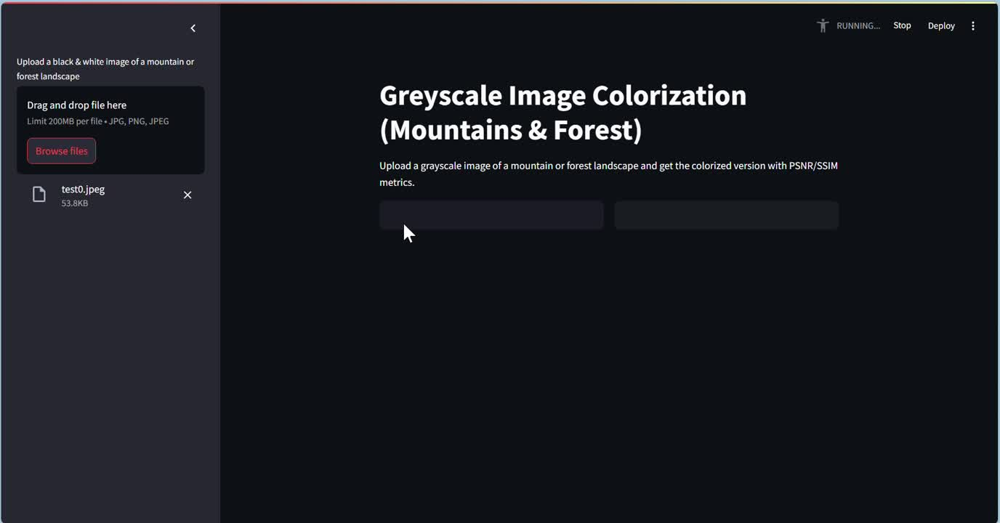
DEMO VIDEO

Slide 14
THANK YOU
FOR YOUR NICE ATTENTION

